Slide 1




Exploring the Exciting World of Modern .NET Development
Matthew Leibowitz @mattleibow

Slide 2
About Me
South African
Left SA in 17
Been 7 since I have been back
Developer at Xamarin for just over 2 years
Developer at Microsoft for 8 years

Slide 3
About Me
South African
Left SA on 17 April 2024
Been 77 days since I have been back
Developer at Xamarin for just over 2 years
Developer at Microsoft for 8 years

Slide 4

.NET

Slide 5









.NET
Cloud
Web
Desktop
Mobile
Gaming
IoT
AI
+
+
Visual Studio
Visual Studio Code
CLI
Linux
NuGet
GitHub
Components, tools, library vendors
Windows
macOS
Tools
Operating system
Ecosystem

Slide 6




Any Platform
Blazor
.NET MAUI

Slide 7
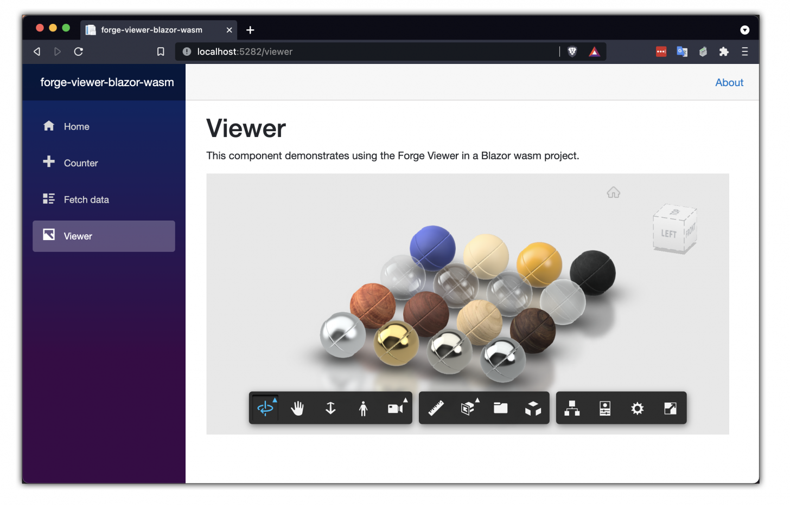
First Party
Blazor

Slide 8
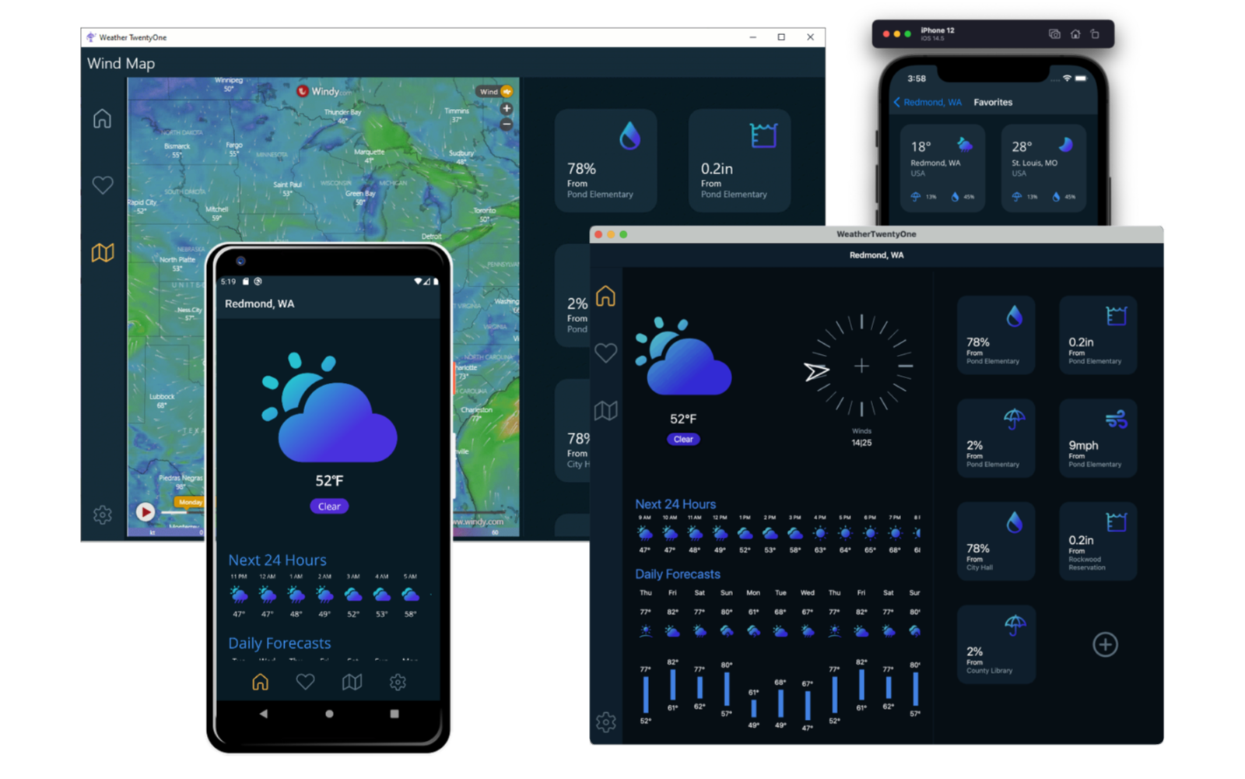
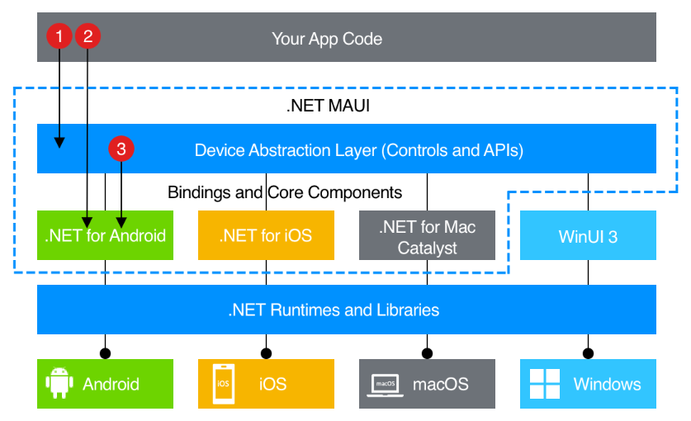
First Party
.NET MAUI

Slide 9

BLAZOR
C#, HTML, JS, CSS
BLAZOR + .NET MAUI
.NET MAUI, WinUI, WPF
C#, XAML
Reach
Depth
Websites and PWAs
Hybrid
Native

Slide 10
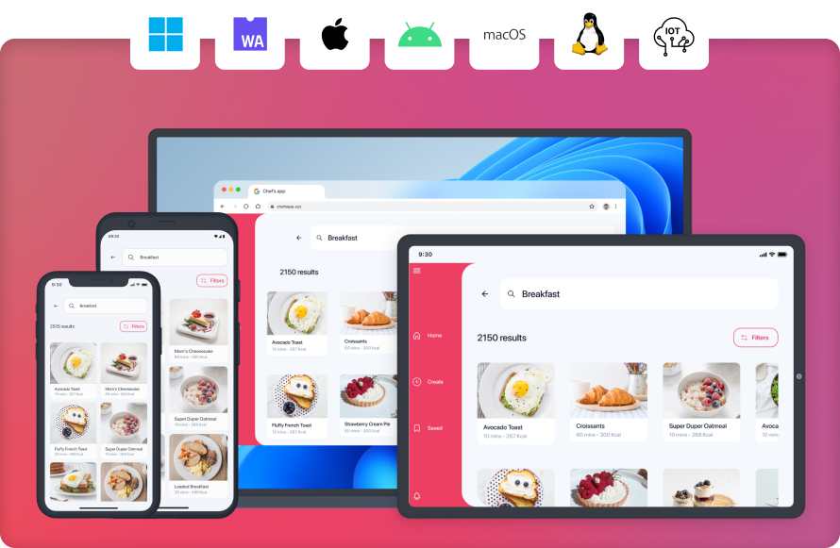
Third Party

Slide 11
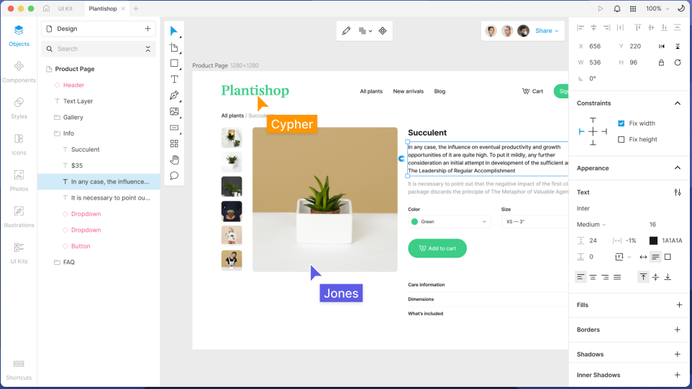
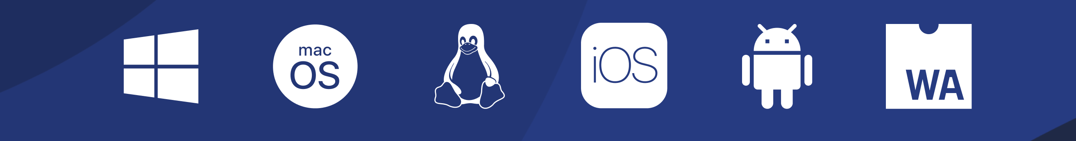
Third Party

Slide 12



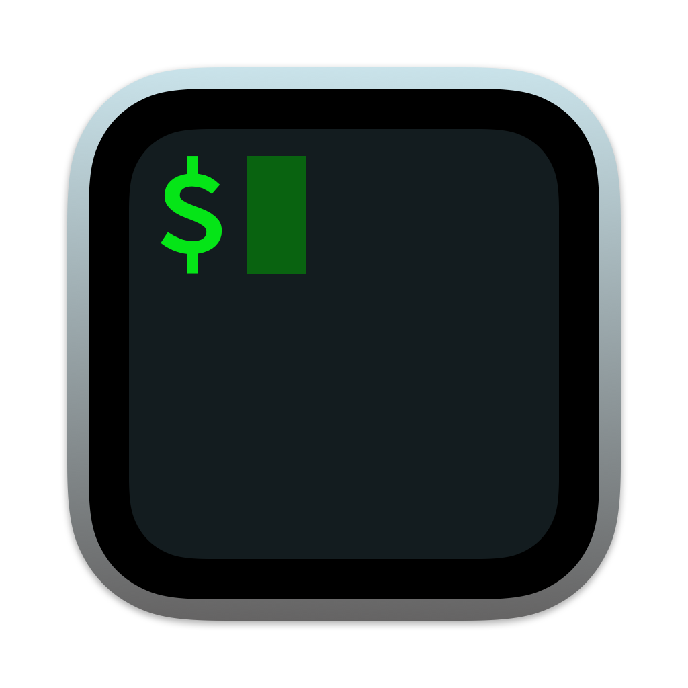


Any Environment
Visual Studio
Command Line
JetBrains Rider
Visual Studio Code

Slide 13
Visual Studio Code

Slide 14
Visual Studio Code
Lightweight
Powerful
Source code editor
Windows, macOS, Linux
Rich ecosystem Extensions

Slide 15
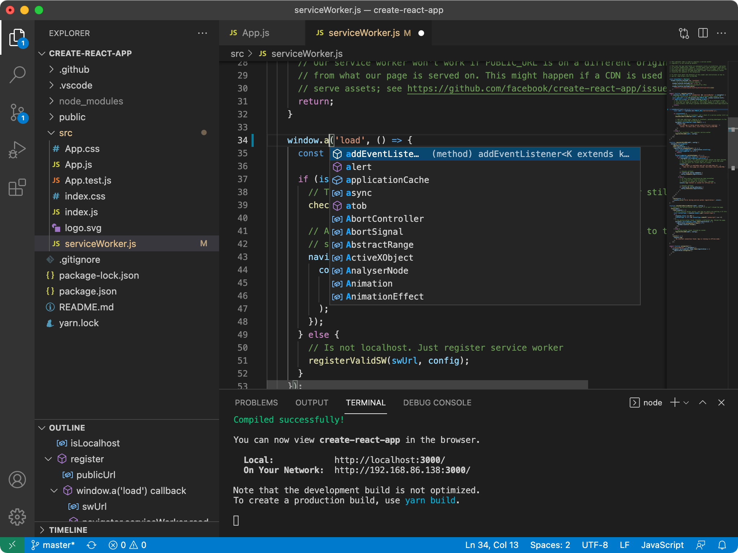

Slide 16
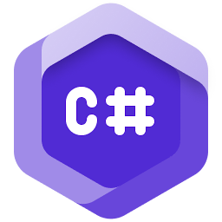
C# Dev Kit for Visual Studio Code

Slide 17
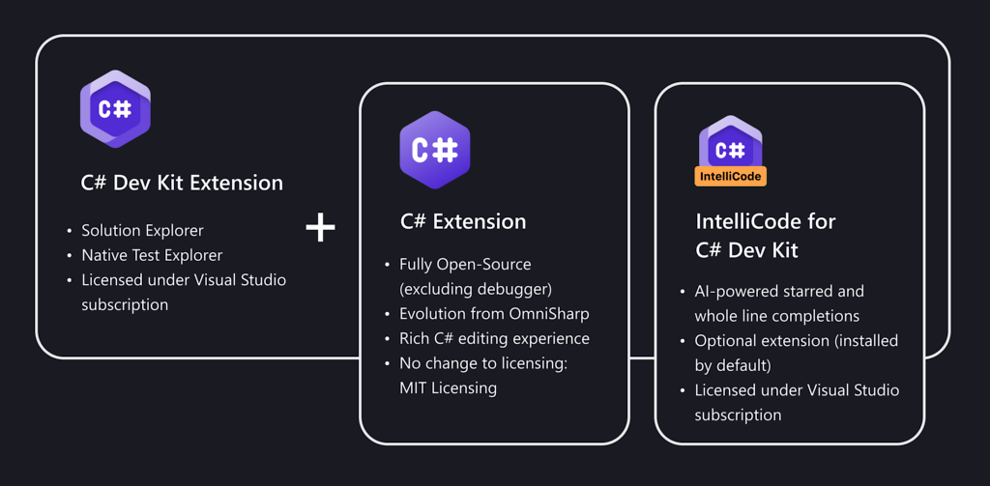

Slide 18

.NET MAUI Dev Kit for VS Code

Slide 19
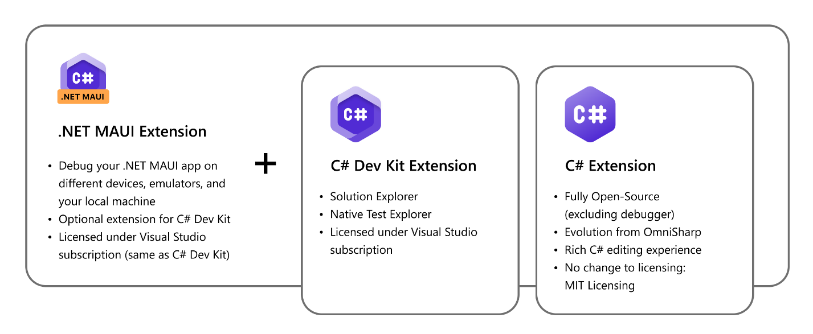

Slide 20


Docker and Containers

Slide 21
Ensures consistent application behavior
Lightweight and efficient
Enhances application security
Ideal for microservices architectures
Supported by a robust community and ecosystem
Runs seamlessly across different platforms
Application Containerization

Slide 22






Client
Host
Registry
Daemon
docker pull
my-app-ai
my-app-db
docker build
my-app-api
my-app-web
.NET
.NET
docker run
.NET
.NET
Containers
Images

Slide 23
MS SQL Server on macOS
docker pull mcr.microsoft.com/azure-sql-edge:latest
docker run \
-e "ACCEPT_EULA=Y" \
-e "MSSQL_SA_PASSWORD=MyPass@word" \
-p 1433:1433 \
-d \
mcr.microsoft.com/azure-sql-edge:latest

Slide 24
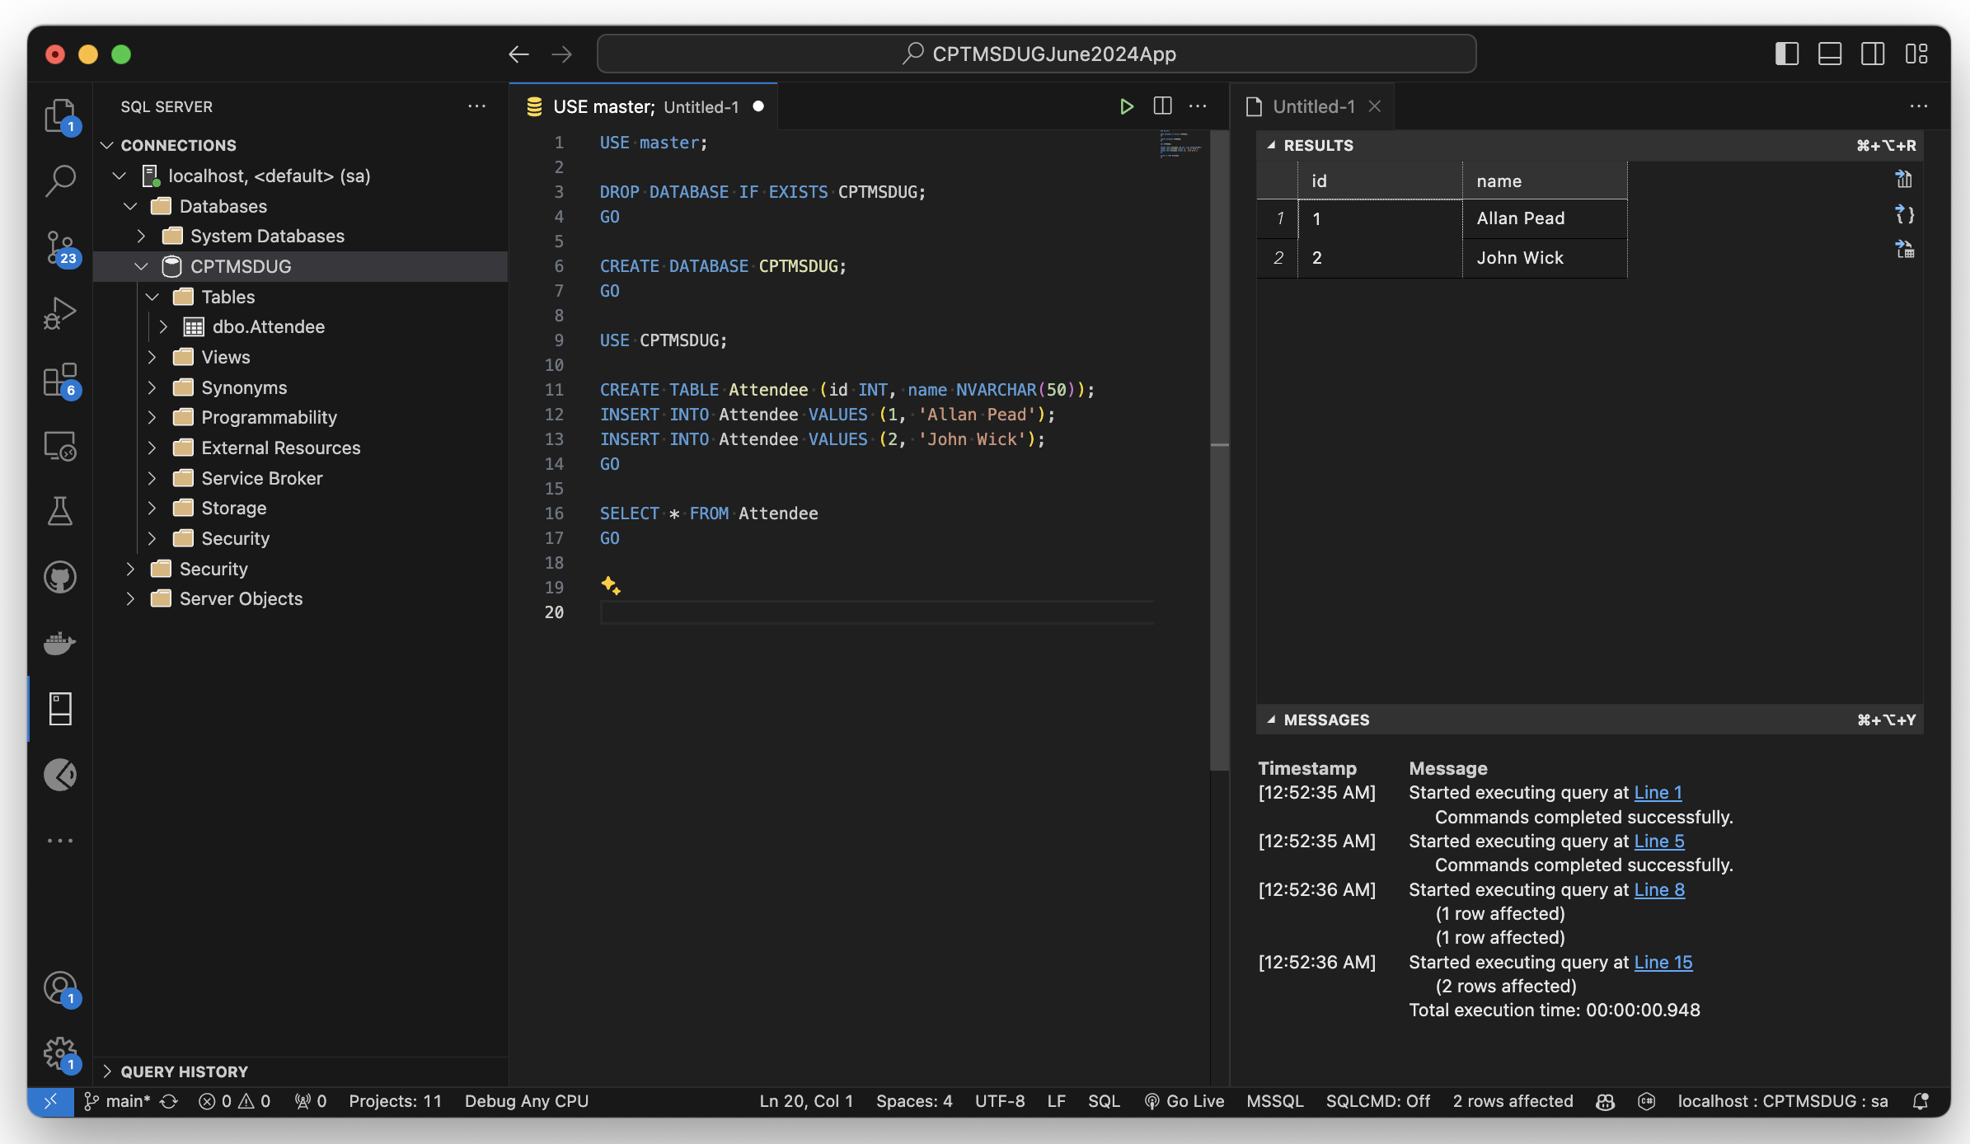
MS SQL Server on macOS

Slide 25
Dockerfile
FROM mcr.microsoft.com/dotnet/sdk:8.0 AS build-env
WORKDIR /working
COPY . ./
RUN dotnet restore
RUN dotnet publish -c Release -o out
FROM mcr.microsoft.com/dotnet/aspnet:8.0
WORKDIR /app
COPY --from=build-env /working/out .
ENTRYPOINT ["dotnet", ”MyApp.dll"]

Slide 26
docker build & run
docker build -t my-image-name .
docker run -it --rm -p 8080:8080 my-image-name

Slide 27

Dev Tunnels

Slide 28
Local Endpoint
Public Endpoint
Anything
Dev Tunnel
http://localhost:5000/...
https://myapp-5000.devtunnels.ms/...

Slide 29
Temporary Tunnels
devtunnel host --allow-anonymous --port-numbers 8080
Hosting port: 8080
Connect via browser:
https://2x58v37s.asse.devtunnels.ms:8080
https://2x58v37s-8080.asse.devtunnels.ms
Inspect network activity:
https://2x58v37s-8080-inspect.asse.devtunnels.ms
Ready to accept connections for tunnel: neat-lake-wv8w8fx

Slide 30
Permanent Tunnels
devtunnel create my-tunnel --allow-anonymous
devtunnel port create my-tunnel --port-number 8080
devtunnel port create my-tunnel --port-number 5050
devtunnel host my-tunnel
...
devtunnel delete my-tunnel

Slide 31
Permanent Tunnels
Hosting port: 5050
Connect via browser:
https://t6k66lx7-5050.asse.devtunnels.ms
Inspect network activity:
https://t6k66lx7-5050-inspect.asse.devtunnels.ms
Hosting port: 8080
Connect via browser:
https://t6k66lx7.asse.devtunnels.ms:8080
https://t6k66lx7-8080.asse.devtunnels.ms
Inspect network activity:
https://t6k66lx7-8080-inspect.asse.devtunnels.ms
Ready to accept connections for tunnel: my-tunnel

Slide 32
Temporary Tunnels
devtunnel show my-tunnel
Tunnel ID : my-tunnel
Access control : {+Anonymous [connect]}
Host connections : 0
Client connections : 0
Current upload rate : 0 MB/s (limit: 20 MB/s)
Current download rate : 0 MB/s (limit: 20 MB/s)
Ports : 2
5050 auto
8080 auto
Tunnel Expiration : 30 days

